Slide 1
[Delete Before Presenting]
This presentation has been created for your use during the CEO CookOff campaign.
  Please keep all colours, fonts, and logos as provided to ensure brand consistency.
  You may present it as-is or customise it with your own introduction and personal story.
  Feel free to share with your team, colleagues, business network, or community to encourage support and donations.
  Slides can be rearranged, edited, or shortened to suit your audience.
Please remove this first slide before sending or presenting externally.
With gratitude,
The OzHarvest Team

Slide 2



<<TITLE>>

Slide 3

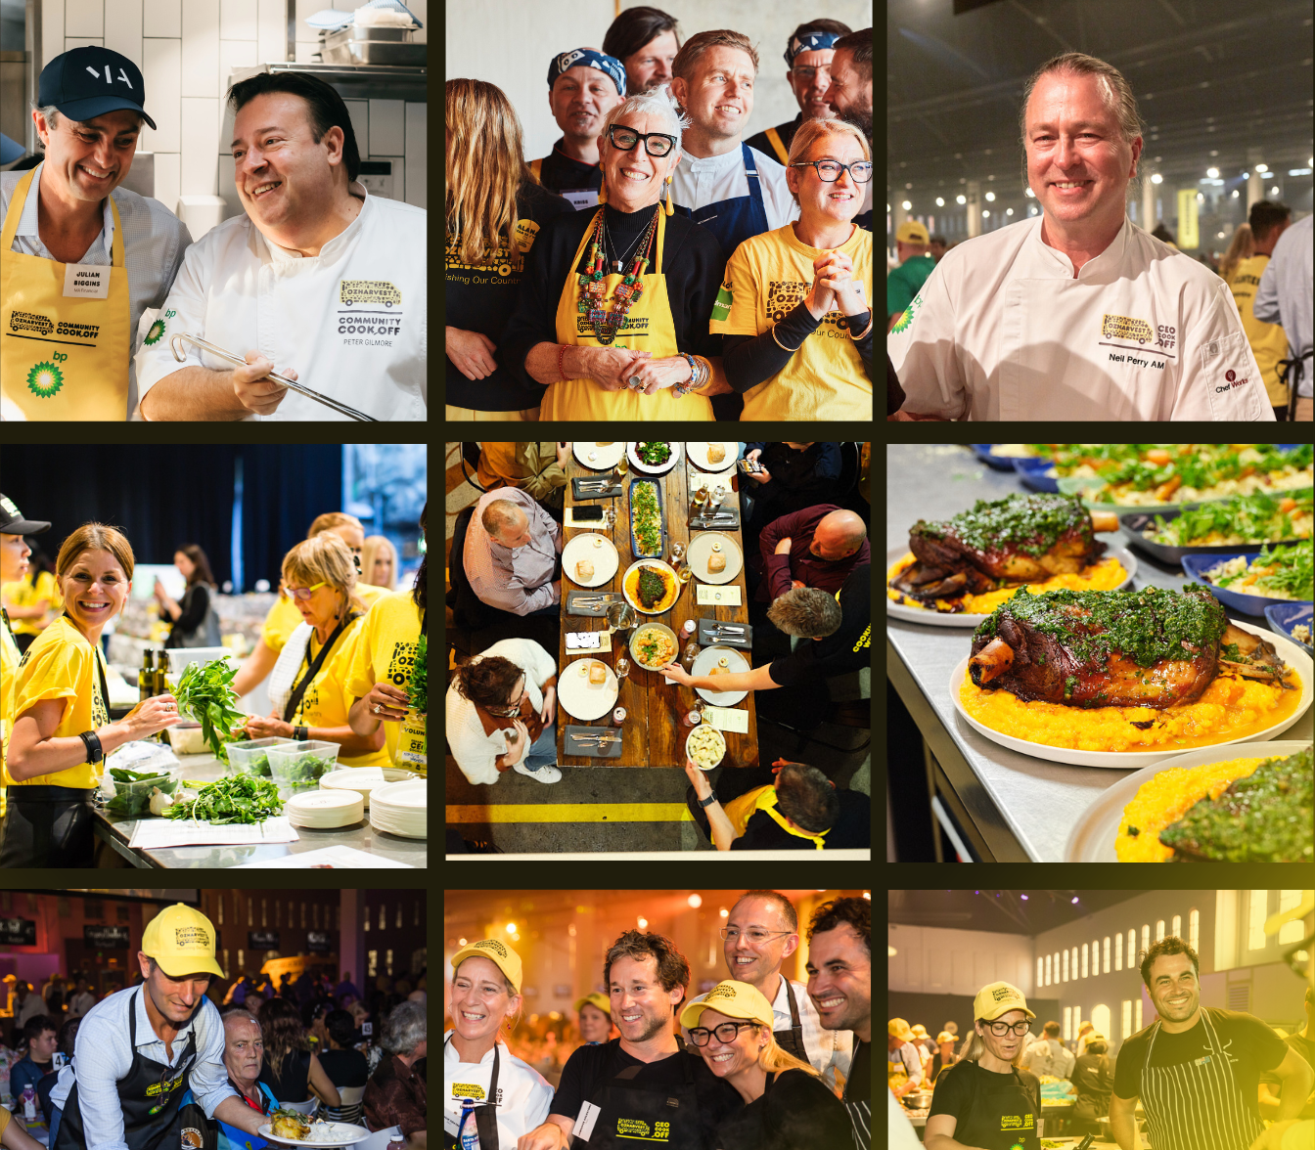


<<TITLE>>
2025
COOK.
CONNECT.
CREATE CHANGE.

Slide 4


HELP ME FEED PEOPLE IN NEED
This October, I’ll be cooking up a storm for OzHarvest’s CEO CookOff, helping raise crucial funds to feed more people in need.
<<INSERT PHOTO OF YOU>>
  3.4 million households are struggling to put food on the table.
  1,551 charities rely on OzHarvest every dat to supply food to people in need.
  72% of charities supported by OzHarvest cannot meet their current demand for food relief.
  31% of people are saying they are seeking food relief for the first time.
Every dollar donated helps provide 2 meals to a perosn in need.
Please scan the QR code to support me.
<<INSERT QR CODE>>

Slide 5
<<TITLE>>
  COPY
COOK.
CONNECT.
CREATE CHANGE.

Slide 6








THE NEED
3.4 MILLION
5,000
1,200
72%
Households experience food insecurity
People go without food each month
Charities are on our waitlist
for food
of charities urgently need
more food
FOOD RELIEF
OZ HARVEST
500,000
$1 = 2 meals
31% need help for the first time, many are googling ‘food relief’ to find help
Australia’s leading food rescue organisation
OzHarvest delivers 500,000 meals a week, but that is not enough to meet demand.
For every dollar donated, OzHarvest can deliver two meals to people in need

Slide 7

SUPPORT ME
<<INSERT QR CODE>>
COOK.
CONNECT.
CREATE CHANGE.

Slide 8
cook. connect. create change.

